Slide 1
Modeling the Percentage of Pneumonia Cases in Java Island Using Two Estimators of Nonparametric Regression for Longitudinal Data
Made Ayu Dwi Octavanny, I Nyoman Budiantara, Heri Kuswanto and Dyah Putri Rahmawati
Department of Statistics, Faculty of Science and Data Analytics, Institut Teknologi Sepuluh Nopember, Surabaya

Slide 2
Outline
Introduction
Literature Review
Truncated Spline Nonparametric Regression
Fourier Series Nonparametric Regression
Data Collection
Result and Discussion
Truncated Spline Estimator
Fourier Series Estimator
Pneumonia Cases in Java Island
Conclusion
References

Slide 3

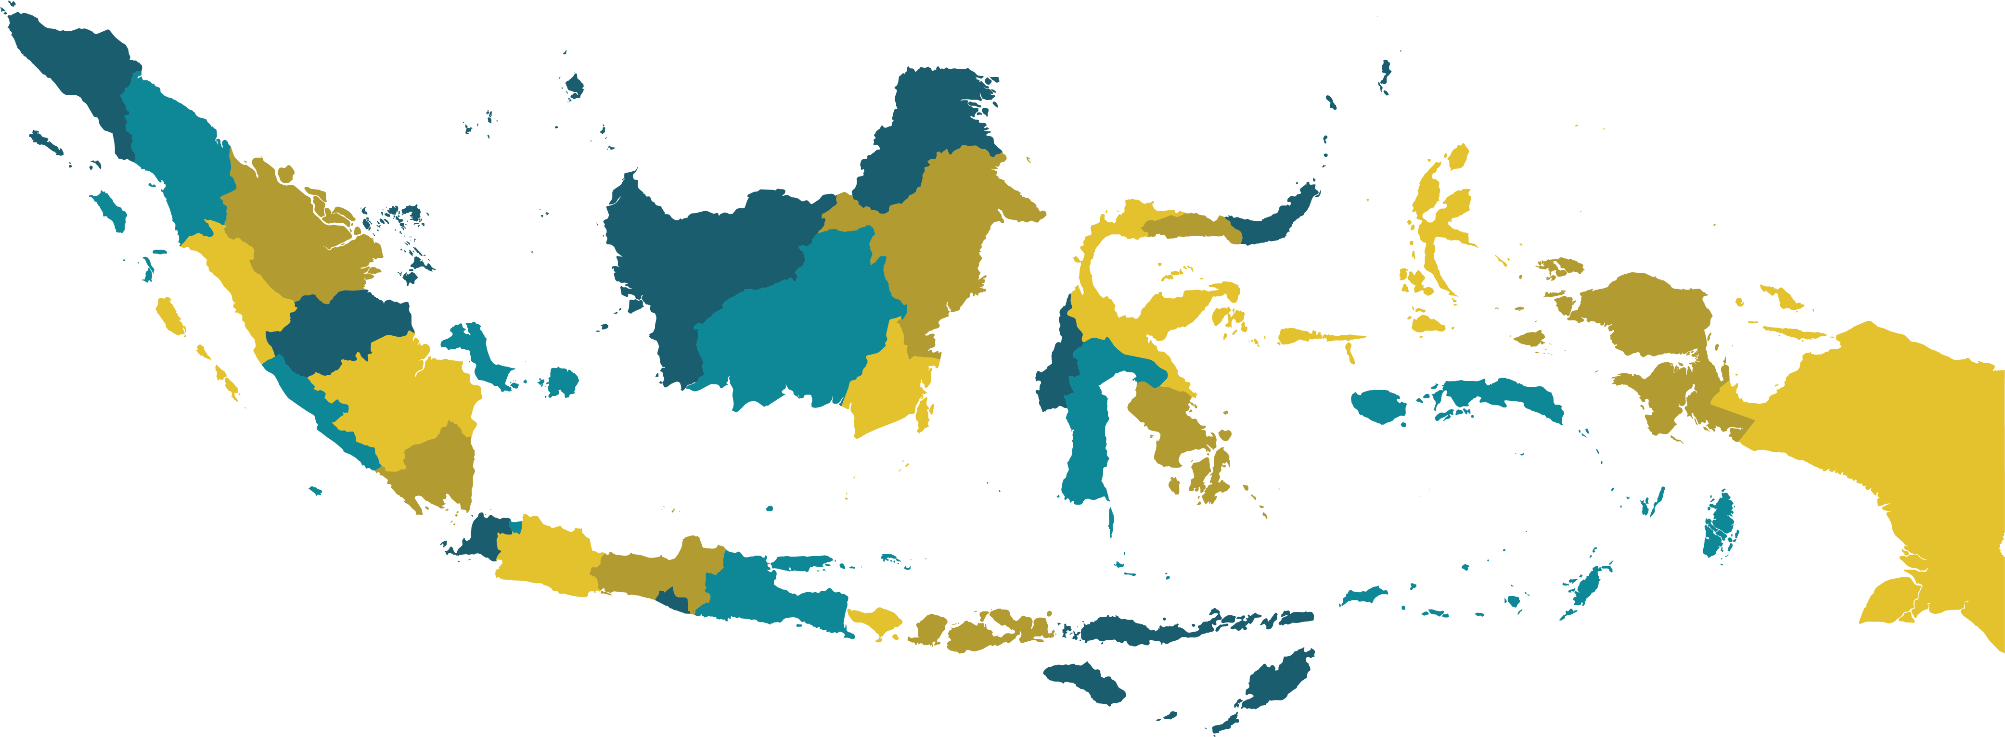

INTRODUCTION
WORLD
INDONESIA
Pneumonia is the single largest infectious cause of death in children worldwide.
15% of children under five years old deaths are caused by pneumonia.
The incidence of pneumonia increased from 2.1% in 2007 to 2.7% in 2013.
In 2018, the mortality rate due to pneumonia in children under five was 0.08%.
The mortality rate due to pneumonia in infants is higher at 0.16% compared to the group of children aged 1-4 years by 0.05%.
JAVA ISLAND
Some provinces in Java, including DKI Jakarta, West Java, and Central Java, have a high prevalence of pneumonia.
The prevalence of pneumonia in West Java is the same as the national prevalence, which is 18.5%.

Slide 4
INTRODUCTION
Data about pneumonia events are recorded every year, it is possible to use longitudinal data analysis.
Regression analysis use to investigate the pattern of the functional relationship between response variables and predictor variables through curve estimation.
The initial study pointed out the factors that influence the pneumonia case in Java Island has no specific pattern.

Slide 5
Study Objectives
To compare two estimators' performance to model the percentage of the pneumonia cases in Java Island.
Two estimators: truncated spline and Fourier series.
The methods will be applied to the pneumonia case dataset in six provinces.

Slide 6
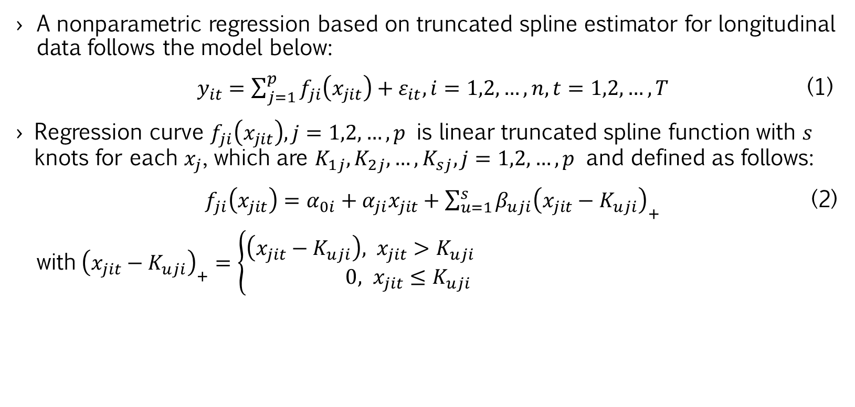
LITERATURE REVIEW
Truncated Spline
Nonparametric Regression
A nonparametric regression based on truncated spline estimator for longitudinal data follows the model below:
$y_{it}=\sum_{j=1}^{p}{f_{ji}\left(x_{jit}\right)}+ε_{it}, i=1,2,…,n, t=1,2,…,T$ (1)
Regression curve $f_{ji}\left(x_{jit}\right), j=1,2,…,p$ is linear truncated spline function with $s$ knots for each $x_{j}$, which are $K_{1j}, K_{2j},…,K_{sj}, j=1,2,…,p$ and defined as follows:
$f_{ji}\left(x_{jit}\right)=α_{0i}+α_{ji}x_{jit}+\sum_{u=1}^{s}{β_{uji}{\left(x_{jit}−K_{uji}\right)}_{+}}$ (2)
with${\left(x_{jit}−K_{uji}\right)}_{+}=\left\{\begin{aligned}\left(x_{jit}−K_{uji}\right), x_{jit}>K_{uji} \\ 0, x_{jit}≤K_{uji}\end{aligned}\right.$

Slide 7
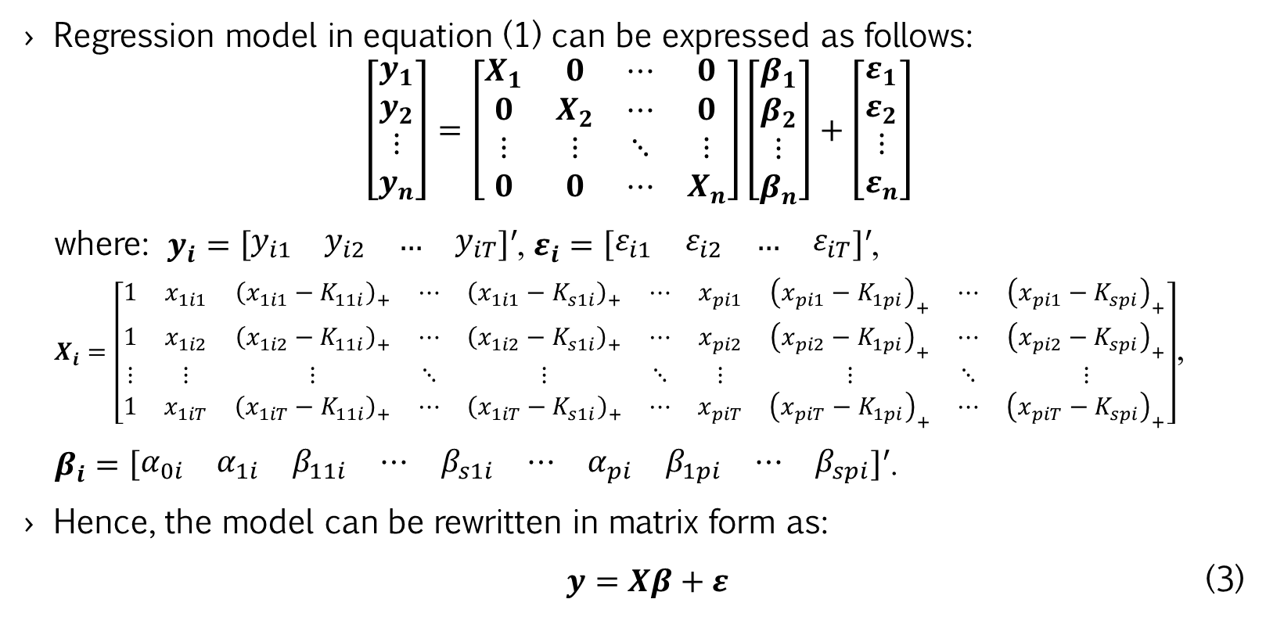
LITERATURE REVIEW
Truncated Spline
Nonparametric Regression
Regression model in equation (1) can be expressed as follows:
$$\left[\begin{matrix}\begin{matrix}y_{1} \\ y_{2}\end{matrix} \\ \begin{matrix}⋮ \\ y_{n}\end{matrix}\end{matrix}\right]=\left[\begin{matrix}X_{1} & 0 & ⋯ & 0 \\ 0 & X_{2} & ⋯ & 0 \\ ⋮ & ⋮ & ⋱ & ⋮ \\ 0 & 0 & ⋯ & X_{n}\end{matrix}\right]\left[\begin{matrix}β_{1} \\ β_{2} \\ ⋮ \\ β_{n}\end{matrix}\right]+\left[\begin{matrix}ε_{1} \\ ε_{2} \\ ⋮ \\ ε_{n}\end{matrix}\right]$$
where: $y_{i}=\left[\begin{matrix}y_{i1} & y_{i2} & … & y_{iT}\end{matrix}\right]′$, $ε_{i}=\left[\begin{matrix}ε_{i1} & ε_{i2} & … & ε_{iT}\end{matrix}\right]′$,
$X_{i}=\left[\begin{matrix}1 & x_{1i1} & {\left(x_{1i1}−K_{11i}\right)}_{+} & ⋯ & {\left(x_{1i1}−K_{s1i}\right)}_{+} & ⋯ & x_{pi1} & {\left(x_{pi1}−K_{1pi}\right)}_{+} & ⋯ & {\left(x_{pi1}−K_{spi}\right)}_{+} \\ 1 & x_{1i2} & {\left(x_{1i2}−K_{11i}\right)}_{+} & ⋯ & {\left(x_{1i2}−K_{s1i}\right)}_{+} & ⋯ & x_{pi2} & {\left(x_{pi2}−K_{1pi}\right)}_{+} & ⋯ & {\left(x_{pi2}−K_{spi}\right)}_{+} \\ ⋮ & ⋮ & ⋮ & ⋱ & ⋮ & ⋱ & ⋮ & ⋮ & ⋱ & ⋮ \\ 1 & x_{1iT} & {\left(x_{1iT}−K_{11i}\right)}_{+} & ⋯ & {\left(x_{1iT}−K_{s1i}\right)}_{+} & ⋯ & x_{piT} & {\left(x_{piT}−K_{1pi}\right)}_{+} & ⋯ & {\left(x_{piT}−K_{spi}\right)}_{+}\end{matrix}\right]$,
$β_{i}=\left[\begin{matrix}α_{0i} & α_{1i} & β_{11i} & ⋯ & β_{s1i} & ⋯ & α_{pi} & β_{1pi} & ⋯ & β_{spi}\end{matrix}\right]′$.
Hence, the model can be rewritten in matrix form as:
$y=Xβ+ε$ (3)

Slide 8
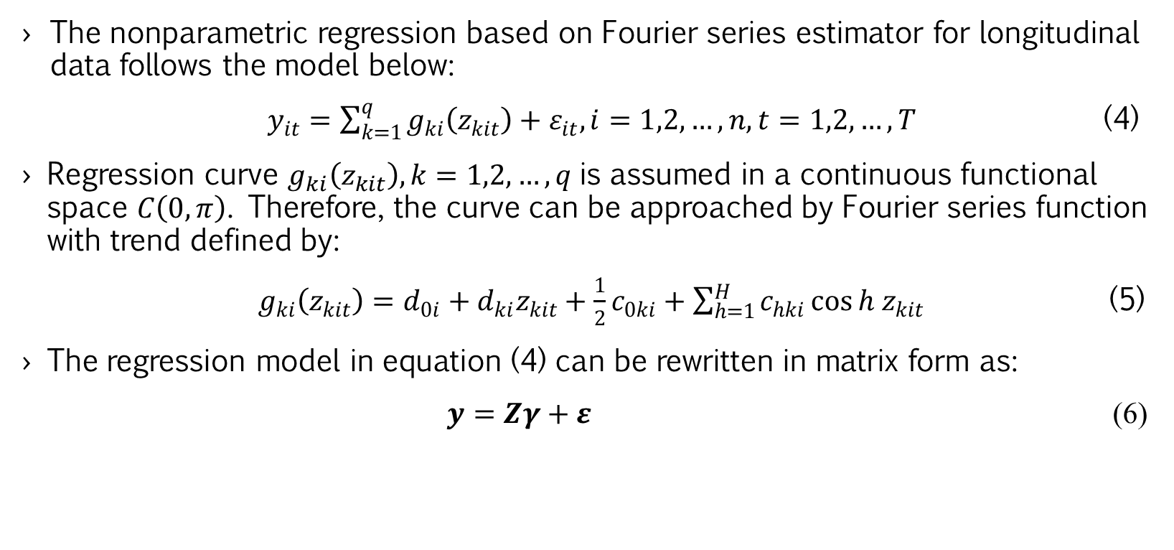
LITERATURE REVIEW
Fourier Series Nonparametric Regression
The nonparametric regression based on Fourier series estimator for longitudinal data follows the model below:
$y_{it}=\sum_{k=1}^{q}{g_{ki}\left(z_{kit}\right)}+ε_{it}, i=1,2,…,n, t=1,2,…,T$ (4)
Regression curve $g_{ki}\left(z_{kit}\right), k=1,2,…,q$ is assumed in a continuous functional space $C\left(0,π\right)$. Therefore, the curve can be approached by Fourier series function with trend defined by:
$g_{ki}\left(z_{kit}\right)=d_{0i}+d_{ki}z_{kit}+\frac{1}{2}c_{0ki}+\sum_{h=1}^{H}{c_{hki}\cos{h z_{kit}}}$ (5)
The regression model in equation (4) can be rewritten in matrix form as:
$y=Zγ+ε$ (6)

Slide 9
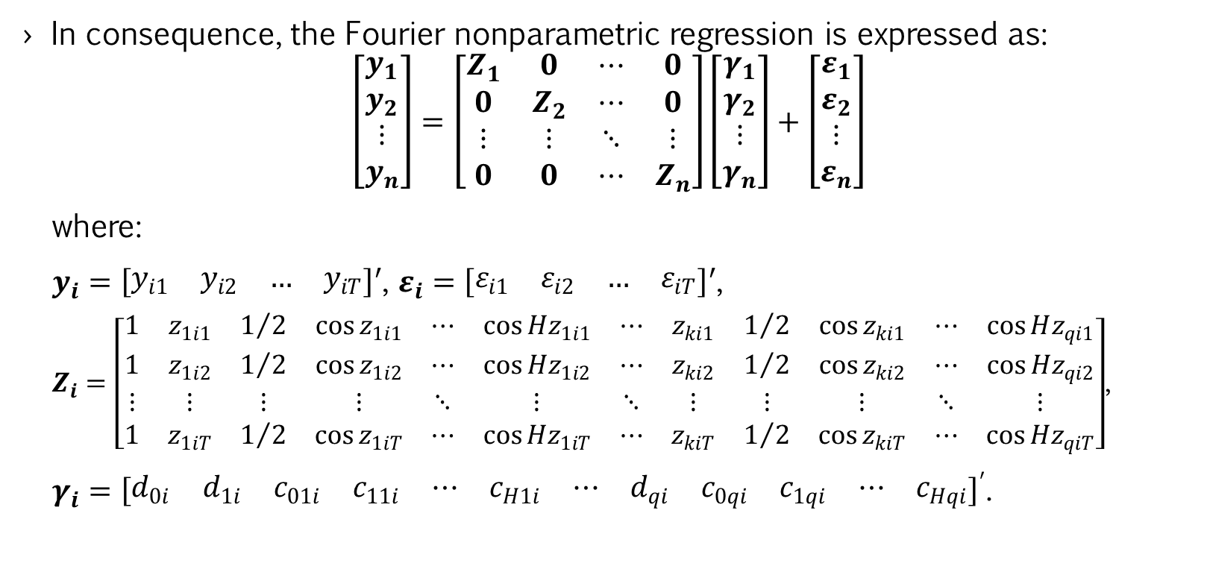
LITERATURE REVIEW
Fourier Series Nonparametric Regression
In consequence, the Fourier nonparametric regression is expressed as:
$$\left[\begin{matrix}\begin{matrix}y_{1} \\ y_{2}\end{matrix} \\ \begin{matrix}⋮ \\ y_{n}\end{matrix}\end{matrix}\right]=\left[\begin{matrix}Z_{1} & 0 & ⋯ & 0 \\ 0 & Z_{2} & ⋯ & 0 \\ ⋮ & ⋮ & ⋱ & ⋮ \\ 0 & 0 & ⋯ & Z_{n}\end{matrix}\right]\left[\begin{matrix}γ_{1} \\ γ_{2} \\ ⋮ \\ γ_{n}\end{matrix}\right]+\left[\begin{matrix}ε_{1} \\ ε_{2} \\ ⋮ \\ ε_{n}\end{matrix}\right]$$
where:
$y_{i}=\left[\begin{matrix}y_{i1} & y_{i2} & … & y_{iT}\end{matrix}\right]′$, $ε_{i}=\left[\begin{matrix}ε_{i1} & ε_{i2} & … & ε_{iT}\end{matrix}\right]′$,
$Z_{i}=\left[\begin{matrix}1 & z_{1i1} & 1/2 & \cos{z_{1i1}} & ⋯ & \cos{Hz_{1i1}} & ⋯ & z_{ki1} & 1/2 & \cos{z_{ki1}} & ⋯ & \cos{Hz_{qi1}} \\ 1 & z_{1i2} & 1/2 & \cos{z_{1i2}} & ⋯ & \cos{{Hz}_{1i2}} & ⋯ & z_{ki2} & 1/2 & \cos{z_{ki2}} & ⋯ & \cos{{Hz}_{qi2}} \\ ⋮ & ⋮ & ⋮ & ⋮ & ⋱ & ⋮ & ⋱ & ⋮ & ⋮ & ⋮ & ⋱ & ⋮ \\ 1 & z_{1iT} & 1/2 & \cos{z_{1iT}} & ⋯ & \cos{{Hz}_{1iT}} & ⋯ & z_{kiT} & 1/2 & \cos{z_{kiT}} & ⋯ & \cos{{Hz}_{qiT}}\end{matrix}\right]$,
$γ_{i}={\left[\begin{matrix}d_{0i} & d_{1i} & c_{01i} & c_{11i} & ⋯ & c_{H1i} & ⋯ & d_{qi} & c_{0qi} & c_{1qi} & ⋯ & c_{Hqi}\end{matrix}\right]}^{′}$.

Slide 10
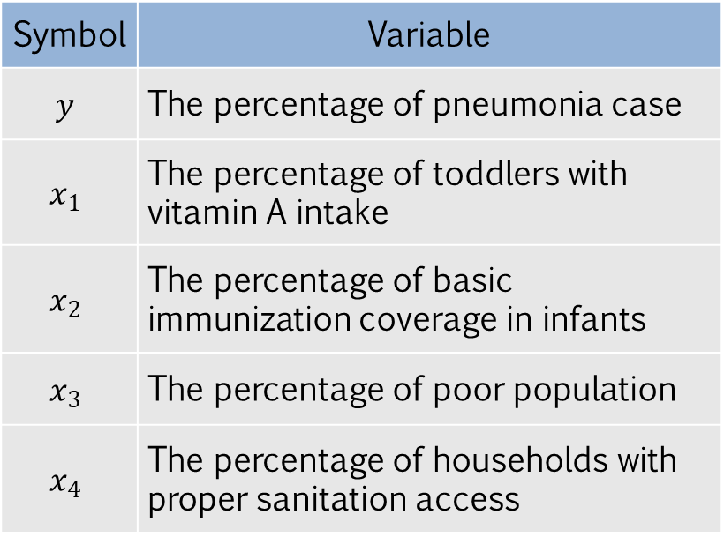
DATA COLLECTION
Six provinces in Java Island, namely DKI Jakarta, West Java, Central Java, DI Yogyakarta, East Java, and Banten.
The data were obtained from the Indonesia Health Profile published by the Indonesian Ministry of Health.
The dataset comprises nine years (2010-2018) data in each province.
Table 1. Research variables
Symbol | Variable
$$y$$ | The percentage of pneumonia case
$$x_{1}$$ | The percentage of toddlers with vitamin A intake
$$x_{2}$$ | The percentage of basic immunization coverage in infants
$$x_{3}$$ | The percentage of poor population
$$x_{4}$$ | The percentage of households with proper sanitation access

Slide 11
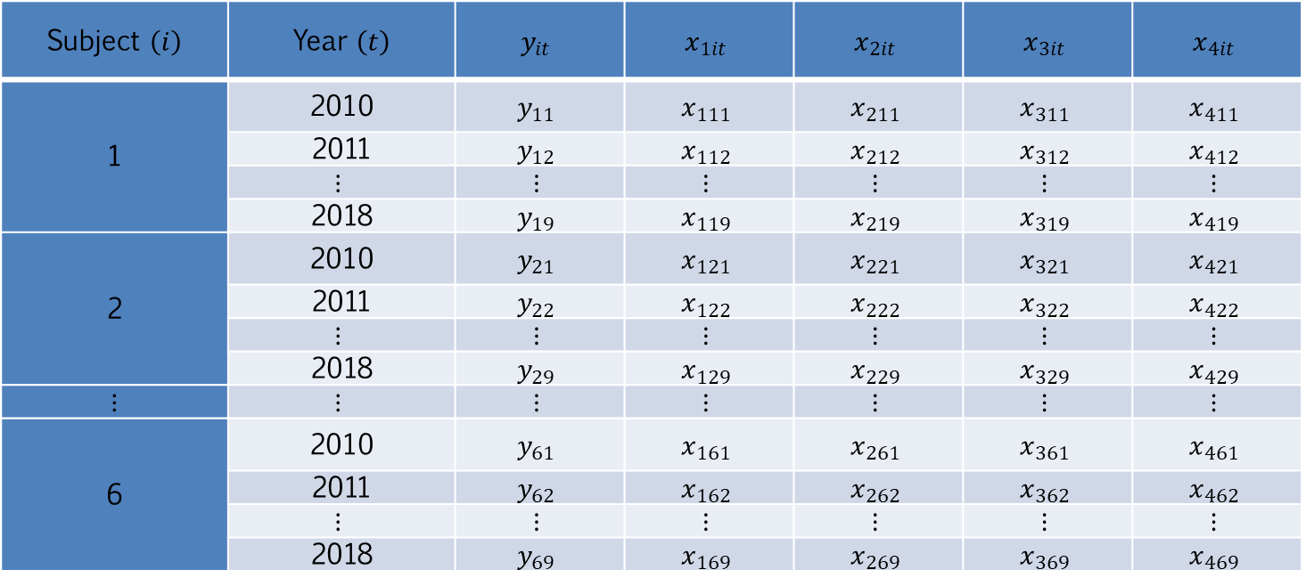
DATA COLLECTION
Table 2. Data structure
Subject $\left(i\right)$ | Year $\left(t\right)$ | $$y_{it}$$ | $$x_{1it}$$ | $$x_{2it}$$ | $$x_{3it}$$ | $$x_{4it}$$
1 | 2010 | $$y_{11}$$ | $$x_{111}$$ | $$x_{211}$$ | $$x_{311}$$ | $$x_{411}$$
 | 2011 | $$y_{12}$$ | $$x_{112}$$ | $$x_{212}$$ | $$x_{312}$$ | $$x_{412}$$
 | $$⋮$$ | $$⋮$$ | $$⋮$$ | $$⋮$$ | $$⋮$$ | $$⋮$$
 | 2018 | $$y_{19}$$ | $$x_{119}$$ | $$x_{219}$$ | $$x_{319}$$ | $$x_{419}$$
2 | 2010 | $$y_{21}$$ | $$x_{121}$$ | $$x_{221}$$ | $$x_{321}$$ | $$x_{421}$$
 | 2011 | $$y_{22}$$ | $$x_{122}$$ | $$x_{222}$$ | $$x_{322}$$ | $$x_{422}$$
 | $$⋮$$ | $$⋮$$ | $$⋮$$ | $$⋮$$ | $$⋮$$ | $$⋮$$
 | 2018 | $$y_{29}$$ | $$x_{129}$$ | $$x_{229}$$ | $$x_{329}$$ | $$x_{429}$$
$$⋮$$ | $$⋮$$ | $$⋮$$ | $$⋮$$ | $$⋮$$ | $$⋮$$ | $$⋮$$
6 | 2010 | $$y_{61}$$ | $$x_{161}$$ | $$x_{261}$$ | $$x_{361}$$ | $$x_{461}$$
 | 2011 | $$y_{62}$$ | $$x_{162}$$ | $$x_{262}$$ | $$x_{362}$$ | $$x_{462}$$
 | $$⋮$$ | $$⋮$$ | $$⋮$$ | $$⋮$$ | $$⋮$$ | $$⋮$$
 | 2018 | $$y_{69}$$ | $$x_{169}$$ | $$x_{269}$$ | $$x_{369}$$ | $$x_{469}$$

Slide 12
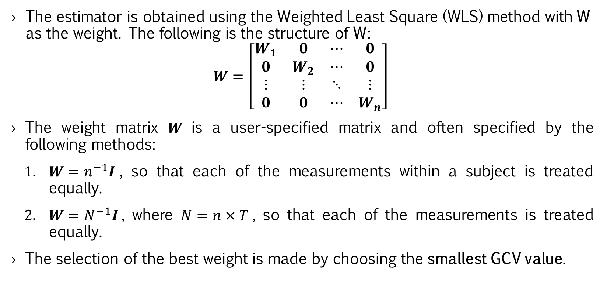
RESULT AND DISCUSSION
The estimator is obtained using the Weighted Least Square (WLS) method with W as the weight. The following is the structure of W:
$$W=\left[\begin{matrix}W_{1} & 0 & ⋯ & 0 \\ 0 & W_{2} & ⋯ & 0 \\ ⋮ & ⋮ & ⋱ & ⋮ \\ 0 & 0 & ⋯ & W_{n}\end{matrix}\right]$$
The weight matrix $W$is a user-specified matrix and often specified by the following methods:
$W=n^{−1}I$, so that each of the measurements within a subject is treated equally.
$W=N^{−1}I$, where $N=n×T$, so that each of the measurements is treated equally.
The selection of the best weight is made by choosing the smallest GCV value.

Slide 13
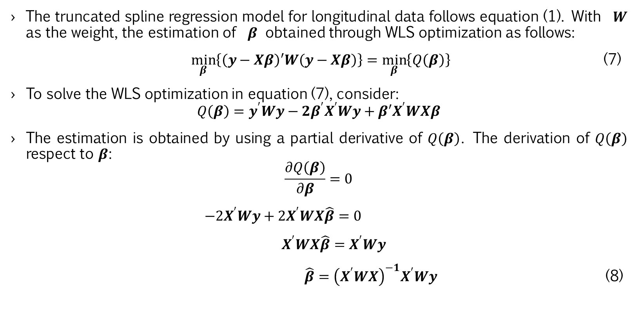
RESULT AND DISCUSSION
Truncated Spline
Estimator
The truncated spline regression model for longitudinal data follows equation (1). With $W$ as the weight, the estimation of $β$ obtained through WLS optimization as follows:
$\min_{β}\left\{\left(y−Xβ\right)′W\left(y−Xβ\right)\right\}=\min_{β}\left\{Q\left(β\right)\right\}$ (7)
To solve the WLS optimization in equation (7), consider:
$$Q\left(β\right)=y^{′}Wy−2β^{′}X^{′}Wy+β′X^{′}WXβ$$
The estimation is obtained by using a partial derivative of $Q\left(β\right)$. The derivation of $Q\left(β\right)$ respect to $β$:
$$\frac{∂Q\left(β\right)}{∂β}=0$$
$−2X^{′}Wy+2X^{′}WX\hat{β}=0$
$X^{′}WX\hat{β}=X^{′}Wy$
$\hat{β}={\left(X^{′}WX\right)}^{−1}X^{′}Wy$ (8)

Slide 14
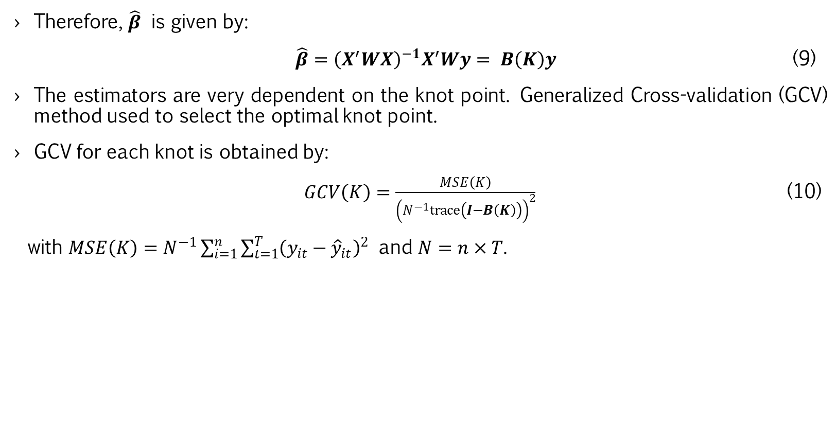
RESULT AND DISCUSSION
Truncated Spline
Estimator
Therefore, $\hat{β}$ is given by:
$\hat{β}={\left(X^{′}WX\right)}^{−1}X^{′}Wy= B\left(K\right)y$ (9)
The estimators are very dependent on the knot point. Generalized Cross-validation (GCV) method used to select the optimal knot point.
GCV for each knot is obtained by:
$GCV\left(K\right)=\frac{MSE\left(K\right)}{{\left(N^{−1}trace\left(I−B\left(K\right)\right)\right)}^{2}}$ (10)
with $MSE\left(K\right)=N^{−1}\sum_{i=1}^{n}{\sum_{t=1}^{T}{{\left(y_{it}−{\hat{y}}_{it}\right)}^{2}}}$ and $N=n×T$.

Slide 15
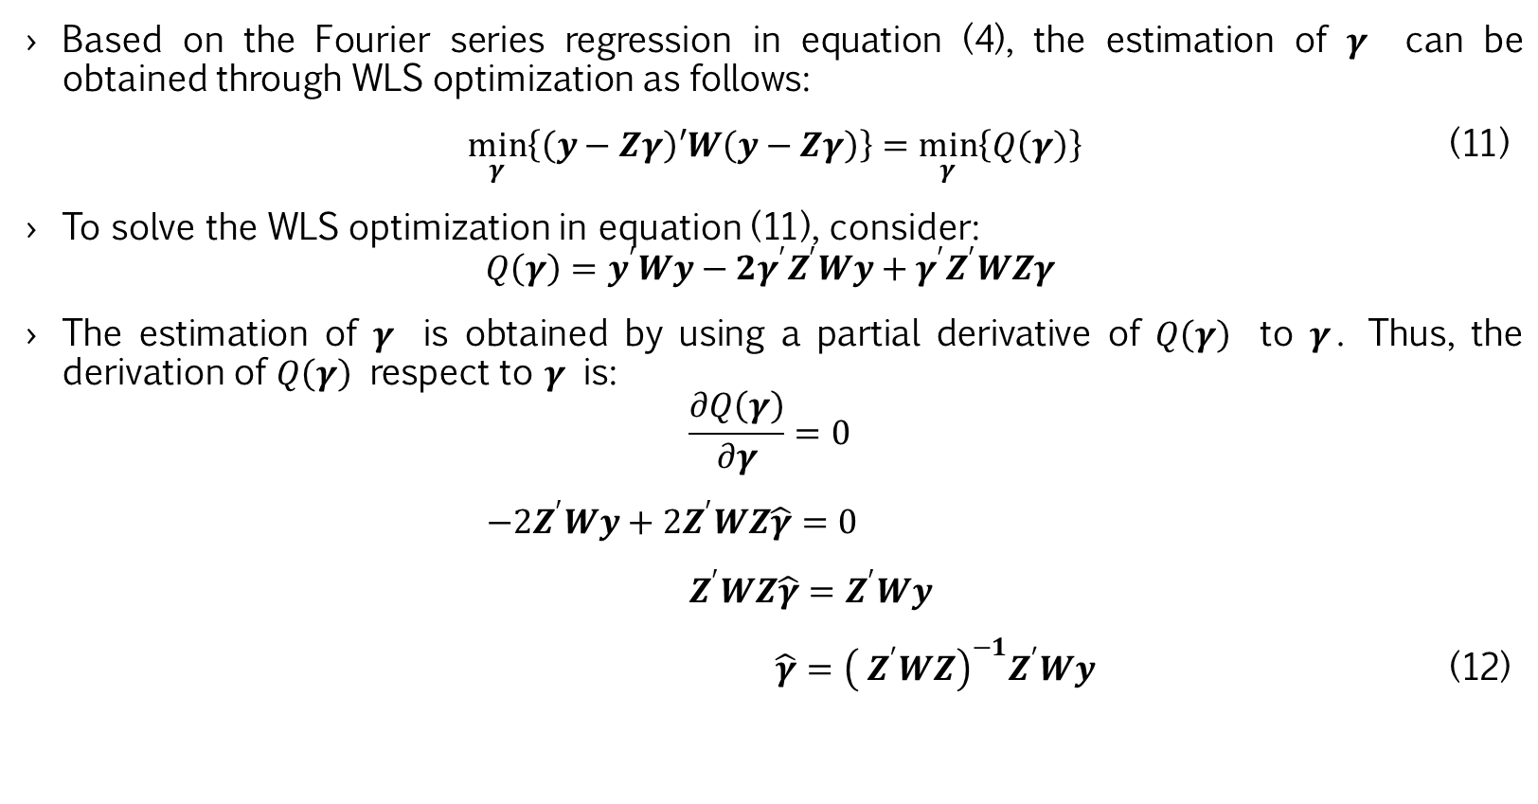
RESULT AND DISCUSSION
Fourier Series
Estimator
Based on the Fourier series regression in equation (4), the estimation of $γ$ can be obtained through WLS optimization as follows:
$\min_{γ}\left\{\left(y−Zγ\right)′W\left(y−Zγ\right)\right\}=\min_{γ}\left\{Q\left(γ\right)\right\}$ (11)
To solve the WLS optimization in equation (11), consider:
$$Q\left(γ\right)=y^{′}Wy−2γ^{′}Z^{′}Wy+γ^{′}Z^{′}WZγ$$
The estimation of $γ$ is obtained by using a partial derivative of $Q\left(γ\right)$ to $γ$. Thus, the derivation of $Q\left(γ\right)$ respect to $γ$ is:
$$\frac{∂Q\left(γ\right)}{∂γ}=0$$
$−2Z^{′}Wy+2Z^{′}WZ\hat{γ}=0$
${ Z}^{′}WZ\hat{γ}=Z^{′}Wy$
$\hat{γ}={\left({ Z}^{′}WZ\right)}^{−1}Z^{′}Wy$ (12)

Slide 16
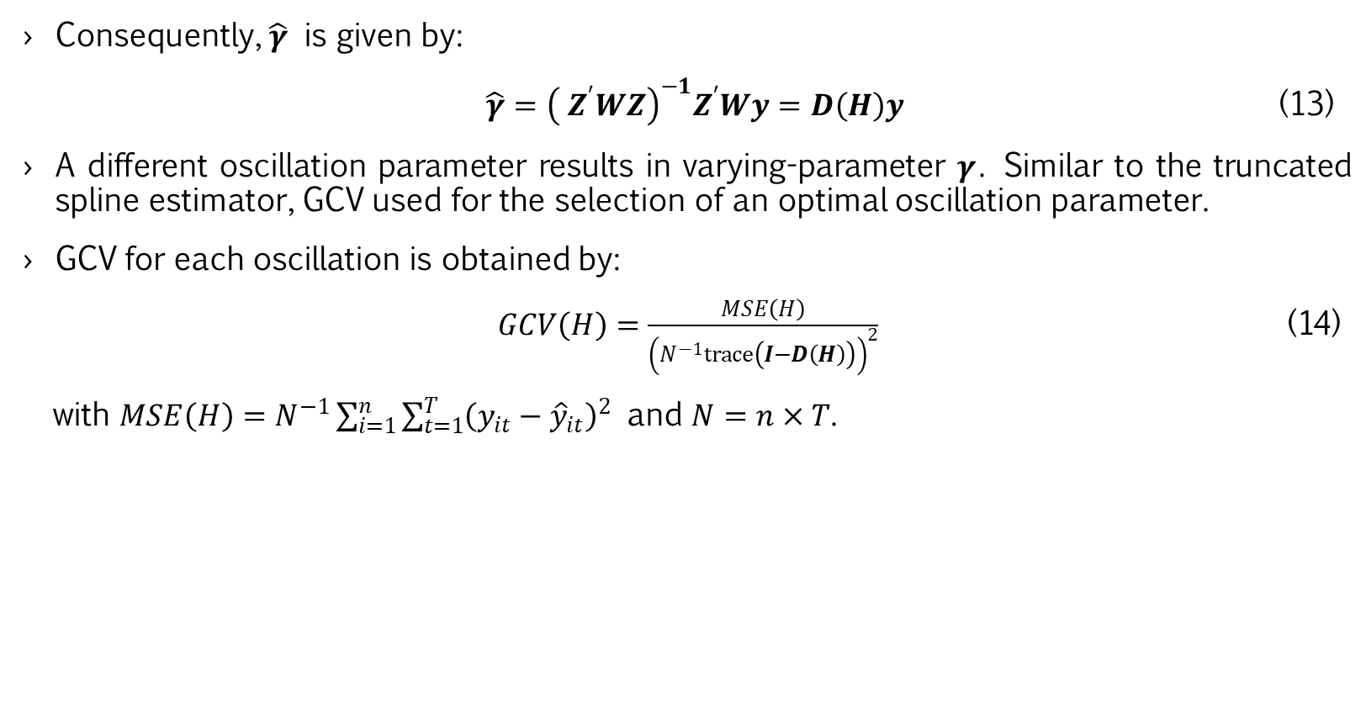
RESULT AND DISCUSSION
Fourier Series
Estimator
Consequently, $\hat{γ}$ is given by:
$\hat{γ}={\left({ Z}^{′}WZ\right)}^{−1}Z^{′}Wy=D\left(H\right)y$ (13)
A different oscillation parameter results in varying-parameter $γ$. Similar to the truncated spline estimator, GCV used for the selection of an optimal oscillation parameter.
GCV for each oscillation is obtained by:
$GCV\left(H\right)=\frac{MSE\left(H\right)}{{\left(N^{−1}trace\left(I−D\left(H\right)\right)\right)}^{2}}$ (14)
with $MSE\left(H\right)=N^{−1}\sum_{i=1}^{n}{\sum_{t=1}^{T}{{\left(y_{it}−{\hat{y}}_{it}\right)}^{2}}}$ and $N=n×T$.

Slide 17
RESULT AND DISCUSSION
Pneumonia Case
in Java Island
(a)
(b)
(c)
(d)
(e)
(f)
Figure 1. Scatterplot between the percentage of pneumonia cases with each predictor for the province: (a) DKI Jakarta, (b) West Java, (c) Central Java, (d) DI Yogyakarta, (e) East Java and (f) Banten

Slide 18
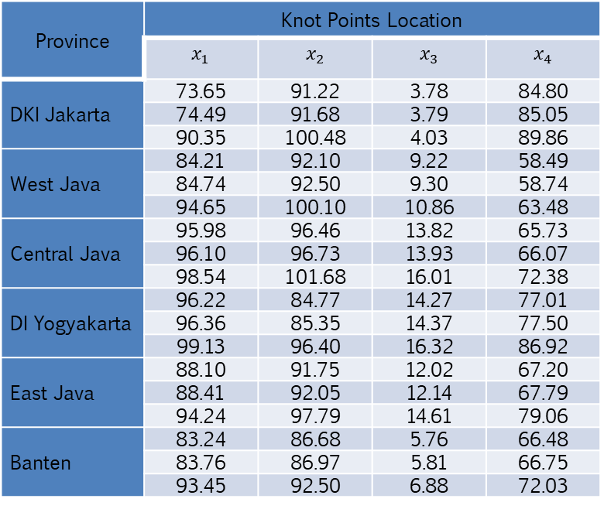
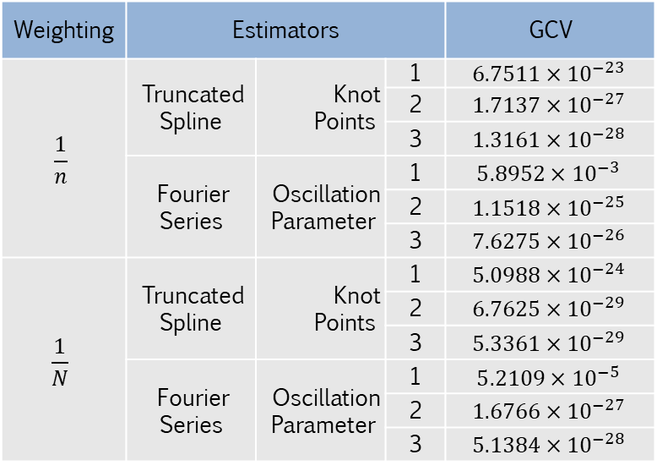
RESULT AND DISCUSSION
Pneumonia Case
in Java Island
Table 3. Comparison of truncated spline and Fourier series estimator
Table 4. Knot points location based on the best model
Weighting | Estimators |  |  | GCV
$$\frac{1}{n}$$ | Truncated Spline | Knot Points | 1 | $$6.7511×{10}^{−23}$$
 |  |  | 2 | $$1.7137×{10}^{−27}$$
 |  |  | 3 | $$1.3161×{10}^{−28}$$
 | Fourier Series | Oscillation Parameter | 1 | $$5.8952×{10}^{−3}$$
 |  |  | 2 | $$1.1518×{10}^{−25}$$
 |  |  | 3 | $$7.6275×{10}^{−26}$$
$$\frac{1}{N}$$ | Truncated Spline | Knot Points | 1 | $$5.0988×{10}^{−24}$$
 |  |  | 2 | $$6.7625×{10}^{−29}$$
 |  |  | 3 | $$5.3361×{10}^{−29}$$
 | Fourier Series | Oscillation Parameter | 1 | $$5.2109×{10}^{−5}$$
 |  |  | 2 | $$1.6766×{10}^{−27}$$
 |  |  | 3 | $$5.1384×{10}^{−28}$$
Province | Knot Points Location
 | $$x_{1}$$ | $$x_{2}$$ | $$x_{3}$$ | $$x_{4}$$
DKI Jakarta | 73.65 | 91.22 | 3.78 | 84.80
 | 74.49 | 91.68 | 3.79 | 85.05
 | 90.35 | 100.48 | 4.03 | 89.86
West Java | 84.21 | 92.10 | 9.22 | 58.49
 | 84.74 | 92.50 | 9.30 | 58.74
 | 94.65 | 100.10 | 10.86 | 63.48
Central Java | 95.98 | 96.46 | 13.82 | 65.73
 | 96.10 | 96.73 | 13.93 | 66.07
 | 98.54 | 101.68 | 16.01 | 72.38
DI Yogyakarta | 96.22 | 84.77 | 14.27 | 77.01
 | 96.36 | 85.35 | 14.37 | 77.50
 | 99.13 | 96.40 | 16.32 | 86.92
East Java | 88.10 | 91.75 | 12.02 | 67.20
 | 88.41 | 92.05 | 12.14 | 67.79
 | 94.24 | 97.79 | 14.61 | 79.06
Banten | 83.24 | 86.68 | 5.76 | 66.48
 | 83.76 | 86.97 | 5.81 | 66.75
 | 93.45 | 92.50 | 6.88 | 72.03

Slide 19
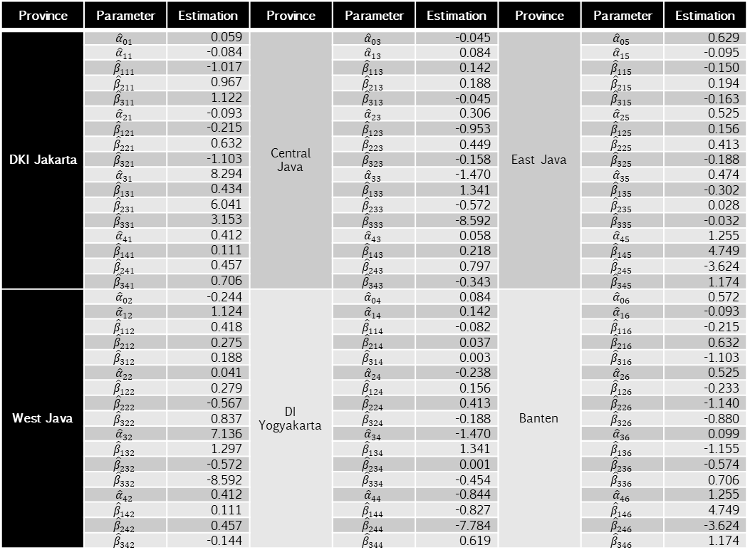
RESULT AND DISCUSSION
Pneumonia Case
in Java Island
Table 5. Results of parameter estimation
Province | Parameter | Estimation | Province | Parameter | Estimation | Province | Parameter | Estimation
DKI Jakarta | $${\hat{α}}_{01}$$ | 0.059 | Central Java | $${\hat{α}}_{03}$$ | -0.045 | East Java | $${\hat{α}}_{05}$$ | 0.629
 | $${\hat{α}}_{11}$$ | -0.084 |  | $${\hat{α}}_{13}$$ | 0.084 |  | $${\hat{α}}_{15}$$ | -0.095
 | $${\hat{β}}_{111}$$ | -1.017 |  | $${\hat{β}}_{113}$$ | 0.142 |  | $${\hat{β}}_{115}$$ | -0.150
 | $${\hat{β}}_{211}$$ | 0.967 |  | $${\hat{β}}_{213}$$ | 0.188 |  | $${\hat{β}}_{215}$$ | 0.194
 | $${\hat{β}}_{311}$$ | 1.122 |  | $${\hat{β}}_{313}$$ | -0.045 |  | $${\hat{β}}_{315}$$ | -0.163
 | $${\hat{α}}_{21}$$ | -0.093 |  | $${\hat{α}}_{23}$$ | 0.306 |  | $${\hat{α}}_{25}$$ | 0.525
 | $${\hat{β}}_{121}$$ | -0.215 |  | $${\hat{β}}_{123}$$ | -0.953 |  | $${\hat{β}}_{125}$$ | 0.156
 | $${\hat{β}}_{221}$$ | 0.632 |  | $${\hat{β}}_{223}$$ | 0.449 |  | $${\hat{β}}_{225}$$ | 0.413
 | $${\hat{β}}_{321}$$ | -1.103 |  | $${\hat{β}}_{323}$$ | -0.158 |  | $${\hat{β}}_{325}$$ | -0.188
 | $${\hat{α}}_{31}$$ | 8.294 |  | $${\hat{α}}_{33}$$ | -1.470 |  | $${\hat{α}}_{35}$$ | 0.474
 | $${\hat{β}}_{131}$$ | 0.434 |  | $${\hat{β}}_{133}$$ | 1.341 |  | $${\hat{β}}_{135}$$ | -0.302
 | $${\hat{β}}_{231}$$ | 6.041 |  | $${\hat{β}}_{233}$$ | -0.572 |  | $${\hat{β}}_{235}$$ | 0.028
 | $${\hat{β}}_{331}$$ | 3.153 |  | $${\hat{β}}_{333}$$ | -8.592 |  | $${\hat{β}}_{335}$$ | -0.032
 | $${\hat{α}}_{41}$$ | 0.412 |  | $${\hat{α}}_{43}$$ | 0.058 |  | $${\hat{α}}_{45}$$ | 1.255
 | $${\hat{β}}_{141}$$ | 0.111 |  | $${\hat{β}}_{143}$$ | 0.218 |  | $${\hat{β}}_{145}$$ | 4.749
 | $${\hat{β}}_{241}$$ | 0.457 |  | $${\hat{β}}_{243}$$ | 0.797 |  | $${\hat{β}}_{245}$$ | -3.624
 | $${\hat{β}}_{341}$$ | 0.706 |  | $${\hat{β}}_{343}$$ | -0.343 |  | $${\hat{β}}_{345}$$ | 1.174
West Java | $${\hat{α}}_{02}$$ | -0.244 | DI Yogyakarta | $${\hat{α}}_{04}$$ | 0.084 | Banten | $${\hat{α}}_{06}$$ | 0.572
 | $${\hat{α}}_{12}$$ | 1.124 |  | $${\hat{α}}_{14}$$ | 0.142 |  | $${\hat{α}}_{16}$$ | -0.093
 | $${\hat{β}}_{112}$$ | 0.418 |  | $${\hat{β}}_{114}$$ | -0.082 |  | $${\hat{β}}_{116}$$ | -0.215
 | $${\hat{β}}_{212}$$ | 0.275 |  | $${\hat{β}}_{214}$$ | 0.037 |  | $${\hat{β}}_{216}$$ | 0.632
 | $${\hat{β}}_{312}$$ | 0.188 |  | $${\hat{β}}_{314}$$ | 0.003 |  | $${\hat{β}}_{316}$$ | -1.103
 | $${\hat{α}}_{22}$$ | 0.041 |  | $${\hat{α}}_{24}$$ | -0.238 |  | $${\hat{α}}_{26}$$ | 0.525
 | $${\hat{β}}_{122}$$ | 0.279 |  | $${\hat{β}}_{124}$$ | 0.156 |  | $${\hat{β}}_{126}$$ | -0.233
 | $${\hat{β}}_{222}$$ | -0.567 |  | $${\hat{β}}_{224}$$ | 0.413 |  | $${\hat{β}}_{226}$$ | -1.140
 | $${\hat{β}}_{322}$$ | 0.837 |  | $${\hat{β}}_{324}$$ | -0.188 |  | $${\hat{β}}_{326}$$ | -0.880
 | $${\hat{α}}_{32}$$ | 7.136 |  | $${\hat{α}}_{34}$$ | -1.470 |  | $${\hat{α}}_{36}$$ | 0.099
 | $${\hat{β}}_{132}$$ | 1.297 |  | $${\hat{β}}_{134}$$ | 1.341 |  | $${\hat{β}}_{136}$$ | -1.155
 | $${\hat{β}}_{232}$$ | -0.572 |  | $${\hat{β}}_{234}$$ | 0.001 |  | $${\hat{β}}_{236}$$ | -0.574
 | $${\hat{β}}_{332}$$ | -8.592 |  | $${\hat{β}}_{334}$$ | -0.454 |  | $${\hat{β}}_{336}$$ | 0.706
 | $${\hat{α}}_{42}$$ | 0.412 |  | $${\hat{α}}_{44}$$ | -0.844 |  | $${\hat{α}}_{46}$$ | 1.255
 | $${\hat{β}}_{142}$$ | 0.111 |  | $${\hat{β}}_{144}$$ | -0.827 |  | $${\hat{β}}_{146}$$ | 4.749
 | $${\hat{β}}_{242}$$ | 0.457 |  | $${\hat{β}}_{244}$$ | -7.784 |  | $${\hat{β}}_{246}$$ | -3.624
 | $${\hat{β}}_{342}$$ | -0.144 |  | $${\hat{β}}_{344}$$ | 0.619 |  | $${\hat{β}}_{346}$$ | 1.174

Slide 20
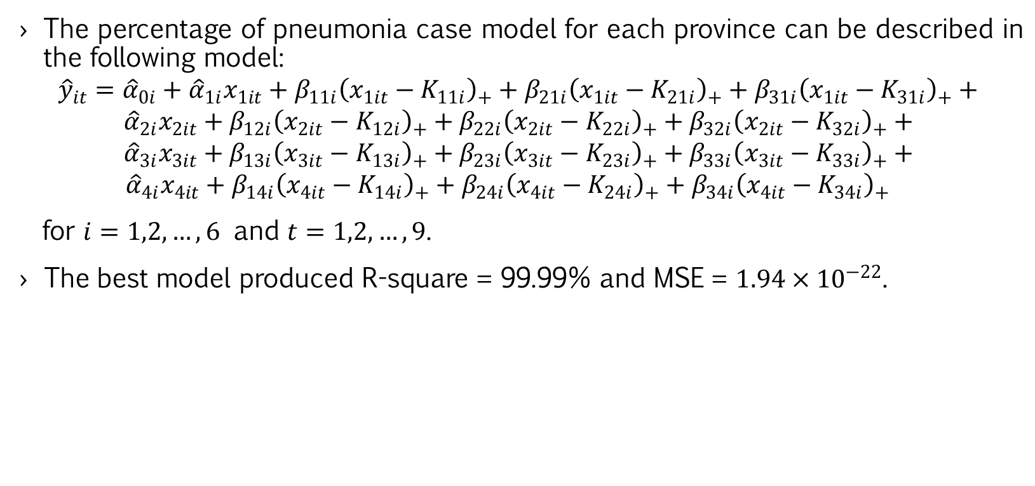
RESULT AND DISCUSSION
Pneumonia Case
in Java Island
The percentage of pneumonia case model for each province can be described in the following model:
$${\hat{y}}_{it}={\hat{α}}_{0i}+{\hat{α}}_{1i}x_{1it}+β_{11i}{\left(x_{1it}−K_{11i}\right)}_{+}+β_{21i}{\left(x_{1it}−K_{21i}\right)}_{+}+β_{31i}{\left(x_{1it}−K_{31i}\right)}_{+}+$$
$${\hat{α}}_{2i}x_{2it}+β_{12i}{\left(x_{2it}−K_{12i}\right)}_{+}+β_{22i}{\left(x_{2it}−K_{22i}\right)}_{+}+β_{32i}{\left(x_{2it}−K_{32i}\right)}_{+}+$$
$${\hat{α}}_{3i}x_{3it}+β_{13i}{\left(x_{3it}−K_{13i}\right)}_{+}+β_{23i}{\left(x_{3it}−K_{23i}\right)}_{+}+β_{33i}{\left(x_{3it}−K_{33i}\right)}_{+}+$$
${\hat{α}}_{4i}x_{4it}+β_{14i}{\left(x_{4it}−K_{14i}\right)}_{+}+β_{24i}{\left(x_{4it}−K_{24i}\right)}_{+}+β_{34i}{\left(x_{4it}−K_{34i}\right)}_{+}$
for $i=1,2,…,6$ and $t=1,2,…,9$.
The best model produced R-square = 99.99% and MSE = $1.94×{10}^{−22}$.

Slide 21
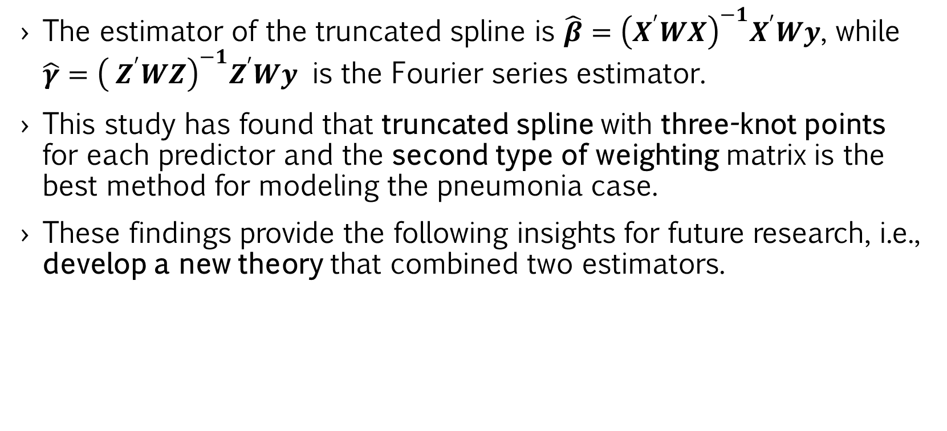
CONCLUSION
The estimator of the truncated spline is $\hat{β}={\left(X^{′}WX\right)}^{−1}X^{′}Wy$, while $\hat{γ}={\left({ Z}^{′}WZ\right)}^{−1}Z^{′}Wy$ is the Fourier series estimator.
This study has found that truncated spline with three-knot points for each predictor and the second type of weighting matrix is the best method for modeling the pneumonia case.
These findings provide the following insights for future research, i.e., develop a new theory that combined two estimators.

Slide 22
REFERENCES
Indonesian Ministry of Health, Indonesia Health Profile 2016 (Indonesian Ministry of Health, Jakarta, 2017).
World Health Organization, “Pneumonia”, retrieved from https://www.who.int/news-room/fact-sheets/detail/pneumonia on 16 July 2020.
National Institute of Health Research and Development, Basic Health Research 2013 (Indonesian Ministry of Health, Jakarta, 2013).
Indonesian Ministry of Health, Indonesia Health Profile 2017 (Indonesian Ministry of Health, Jakarta, 2018).
Yayasan Sayangi Tunas Cilik and Fakultas Keperawatan Universitas Padjajaran, Analisis Situasi Pneumonia pada Anak: Kebijakan di Aras Nasional dan Implementasi Penanganan di Kabupaten Bandung dan Sumba Barat, Indonesia (Yayasan Sayangi Tunas Cilik, Jakarta, 2019).
F. P. Santoso, S. P. Wulandari and Purhadi, Jurnal Sains dan Seni ITS 1(1), 37-42 (2012).
R. L. Eubank, Nonparametric Regression and Spline Smoothing, 2nd ed. (Marcel Dekker, Inc, New York, 1999).
G. Wahba, Spline Models for Observation Data (SIAM Pensylvania, 1990).
I. N. Budiantara, V. Ratnasari, W. Wibowo, N. Afifah, D. P. Rahmawati and M. A. D. Octavanny, Investigacion Operacional 40(4), 538-550 (2019).
M. Bilodeau, The Canadian Journal of Statistics 3, 257-269 (1992).
M. J. Hockenberry and D. Wilson, Wong’s Essentials of Pediatric Nursing, 8th ed. (Elsevier Mosby, St. Louis Missouri, 2009).
S. Hartati, “Analisis Faktor Risiko yang Berhubungan dengan Kejadian Pneumonia pada Anak Balita di RSUD Pasar Rebo Jakarta,”, Tesis, Universitas Indonesia, 2011.
A. Sommer and K. P. West, Vitamin A Deficiency: Health, Survival and Vision (Oxford University Press, New York, 1996).
R. Widoyo, Kesmas: National Public Health Journal 11(1), 46-50 (2016).
R. Machmud, Jurnal Kesehatan Masyarakat Nasional 4(1), 36-41 (2009).
L. K. Thörn, R. Minamisava, S. Nouer, L. H. Ribeiro and A. L. Andrade, BMC Infectious Diseases 11(180), 1-10 (2011).
Indonesian Ministry of Health, Indonesia Health Profile 2012 (Indonesian Ministry of Health, Jakarta, 2013).
H. Wu and J. T. Zhang, Nonparametric Regression Methods for Longitudinal Data Analysis (Wiley-Interscience, Singapore, 2006).

Slide 23
Thank You

